Slide 1

Introduction to Internet

Slide 2
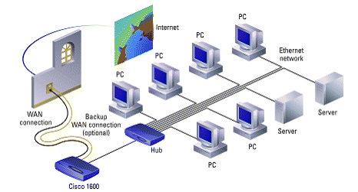
What is the Internet?
The Internet is a huge collection of computers connected in a communication network
Global
Networks of networks

Slide 3
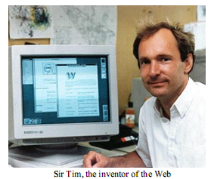
What is WWW?
It is one way of making use of the Internet
It is a collection of software and protocols that has been installed on most computers on the Internet together with the information being shared
Affectionately called “The Web”
Proposed by Sir Tim Berners-Lee at CERN(www.cern.ch) in 1989

Slide 4
How does the Web work?
Web information is stored in the form of web pages
Web pages are stored in the computers called Web servers.
The computers reading the pages are called Web clients.
A Web browser is software used by an end user to access the Web.
Most commonly Firefox or Google chrome.
The web server waits for the request from the web clients over the Internet.
Communication is via Hypertext Transport Protocol (HTTP)
Document representation using Hypertext Markup Language (HTML)

Slide 5
Web terminology
Client
Any computer on the network that requests services from another computer on the network.
Server
Any computer that receives requests from client computers, processes and sends the output.
Web Page
Any page that is hosted on the Internet.
Web Development (our course)
The process of creating and modifying web pages.

Slide 6
Internet Protocols
It is a special set of rules that end points in a telecommunication connection use when they communicate.
Internet Protocol (IP) – To send and receive messages at the internet address level.
Transmission Control Protocol (TCP) – on top of IP, to exchange messages with other Internet points at the information packet level.
On top of TCP/IP, a variety of higher level protocols exist, among which the most important one is Hypertext Transfer Protocol (HTTP) for delivering HTML, sound, audio files on the World Wide Web.

Slide 7
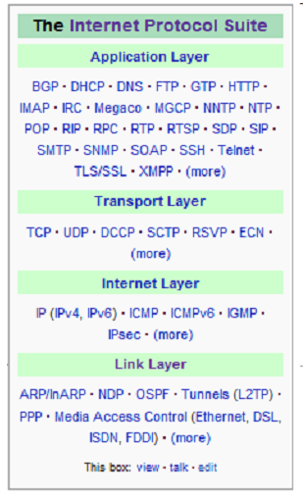
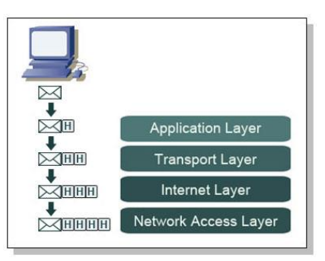
Internet protocols

Slide 8
IP address
The Internet devices are identified by
Device names for people to remember
Numeric addresses (IP) for computers
An IP address is a unique 32-bit number (as in IPv4)
Divided into 4 parts (1 byte each)
For example: 192.164.126.0
Next generation : IPv6 – 128-bit

Slide 9
Domain names
People have difficulties dealing with and remembering numbers;
fortunately devices on the Internet also have textual names
www.dwit.edu.np (___.___.___.___)
There are name servers on the Internet that implement the Domain Name System (DNS)

Slide 10
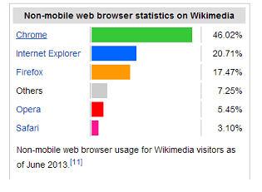
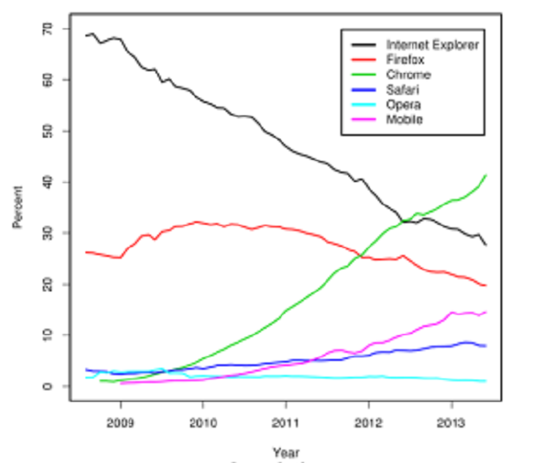
Web browser
Program that retrieves information from web
Netscape, Mosaic
Dead
MS Internet Explorer
Going downhill…
Mozilla/Firefox
Opera (fastest)
Chrome (dominant & faster)

Slide 11
Web server
It is a program that waits for requests from the web browser.
Major functions include
Serving web pages
Controlling access to the server
Monitoring and logging all access
Eg. Apache, Internet Information Service (IIS), etc
More on this topic next week…

Slide 12
The concept of markup language
A Markup language
combines text and extra information about the text.
The extra information, for example about the text's structure or presentation, is expressed using markup
allows us to embed formatting instructions in
the document.

Slide 13
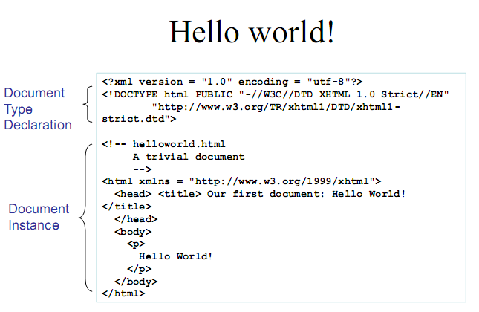
Example

Slide 14
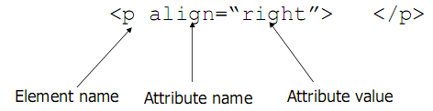
Basic syntax
Elements are defined by tags (markers)
Tags format
Opening tag: <name>
Closing tag: </name>
The opening tag and its closing tag together specify a container for the content they enclose
Not all tags have content
If a tag has no content, its form is <name />

Slide 15
Basic syntax
The container and its content together are called an element
If a tag has attributes, they appear between its name and the right bracket of the opening tag
Comment form: <!-- … -->
Browsers ignore comments, unrecognizable tags, line breaks, multiple spaces, and tabs

Slide 16
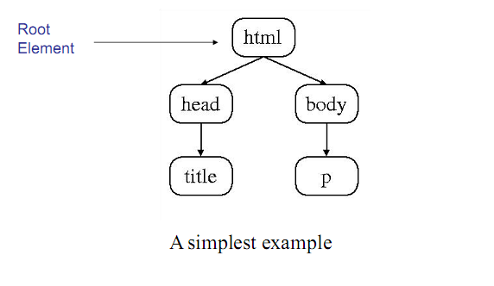
HTML Element Tree

Slide 17
HTML Root Element
Document type declaration specifies name
of root element:
<!DOCTYPE html
Root of HTML document must be html
requires that this element specifies the standard it follow
Example:

Slide 18
HTML head and body Elements
The body element contains information displayed in the browser client area
The head element contains information used for other purposes by the browser:
title (shown in title bar of browser window)
scripts (client-side programs)
style (display) information, e.g. CSS
etc.

Slide 19
Document structure
<html>, <head>, <title>, and <body> are required in every document
The whole document must have <html> as its root
A document consists of one head and one body
The <title> tag is used to give the document a title, which is normally displayed in the browser’s window title bar (at the top of the display)

Slide 20
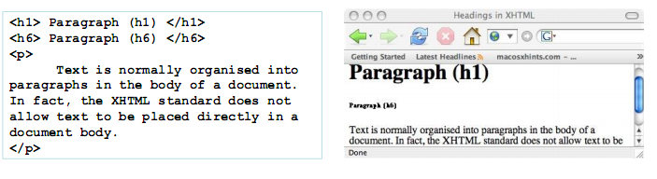
Heading
Six sizes, 1 - 6, specified with <h1> to <h6>
1, 2, and 3 use font sizes that are larger than the
default font size
4 uses the default size
5 and 6 use smaller font sizes

Slide 21
List
Three types of lists in XHTML:
– Unordered: A bulleted list
– Ordered: A numbered list where the order of
items is important
– Definition: A list of terms and definitions for each

